Slide 1
Searching Algorithms

Slide 2
Searching Algorithms:
Searching Algorithms are designed to check for an element or retrieve an element from any data structure where it is stored.
Based on the type of search operation, these algorithms are generally classified into two categories:
Sequential Search: In this, the list or array is traversed sequentially and every element is checked.
For example: Linear Search.

Slide 3
Searching Algorithms:
2.Interval Search: These algorithms are specifically designed for searching in sorted data-structures.
These type of searching algorithms are much more efficient than Linear Search as they repeatedly target the center of the search structure and divide the search space in half.
For Example: Binary Search.

Slide 4
Linear Search

Slide 5
Linear Search
Linear search is a sequential searching algorithm where we start from one end and check every element of the list until the desired element is found.
It is the simplest searching algorithm.

Slide 6
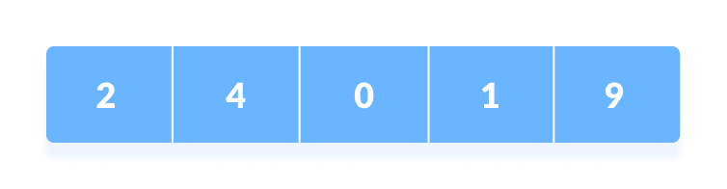
Linear Search
How Linear Search Works?
The following steps are followed to search for an element k = 1 in the list below.
Array to be searched for

Slide 7
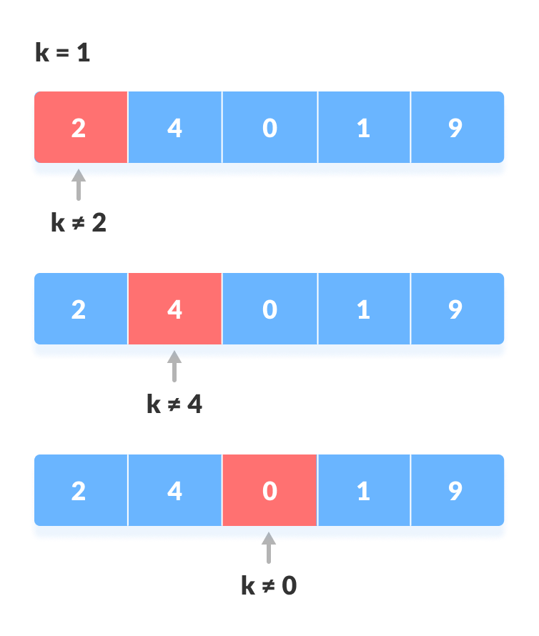
Linear Search
1.Start from the first element, compare k with each element x.
Compare with each element

Slide 8
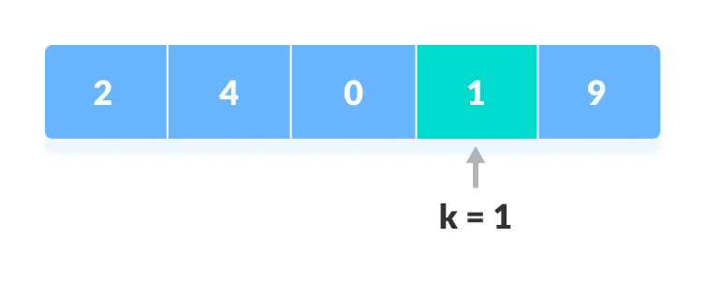
Linear Search
2. If (x == k), return the index.
Element Found

Slide 9
Linear Search
2. If (x == k), return the index.
Element Found
2. Else return Not Found.

Slide 10
Linear Search
Algorithm:
LinearSearch(array, key)
for each item in the array
if item == value
return its index

Slide 11
Linear Search
Linear Search in Python
def linearSearch(array, n, x):
for i in range(0, n):
if (array[i] == x):
return i
return -1
array = [2, 4, 0, 1, 9]
x = 1
n = len(array)
result = linearSearch(array, n, x)
if(result == -1):
print("Element not found")
else:
print("Element found at index: ", result)

